Slide 1
Project 11
Andrew Lin

Slide 2
Use case
Using Dynamic Trust to help first aid respondents and hospital staff find which hospitals have higher trust levels based on their inventory. This can help determine how lenient can be with their staff and also help first aid respondents/ patients find which hospitals to attend for emergencies.
Agents
Hospital’s inventory, patients,
Future:
Respondents

Slide 3
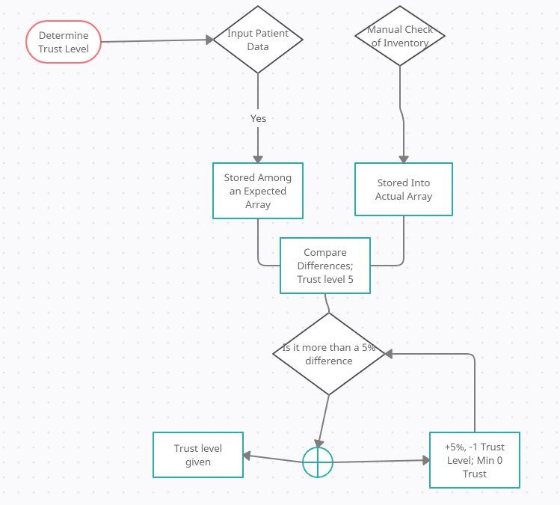
Expectancy vs Reality
Given types of medication
Enter in data needed, ie which medication, amount of medication, the day, and patient number
System stores information in matrix which is compared later to manual inventory count.
Trust level is determined based upon the statistical difference
Future:
The trust level determination can be changed depending on location
Speed up Sorting method with Hashing

Slide 4
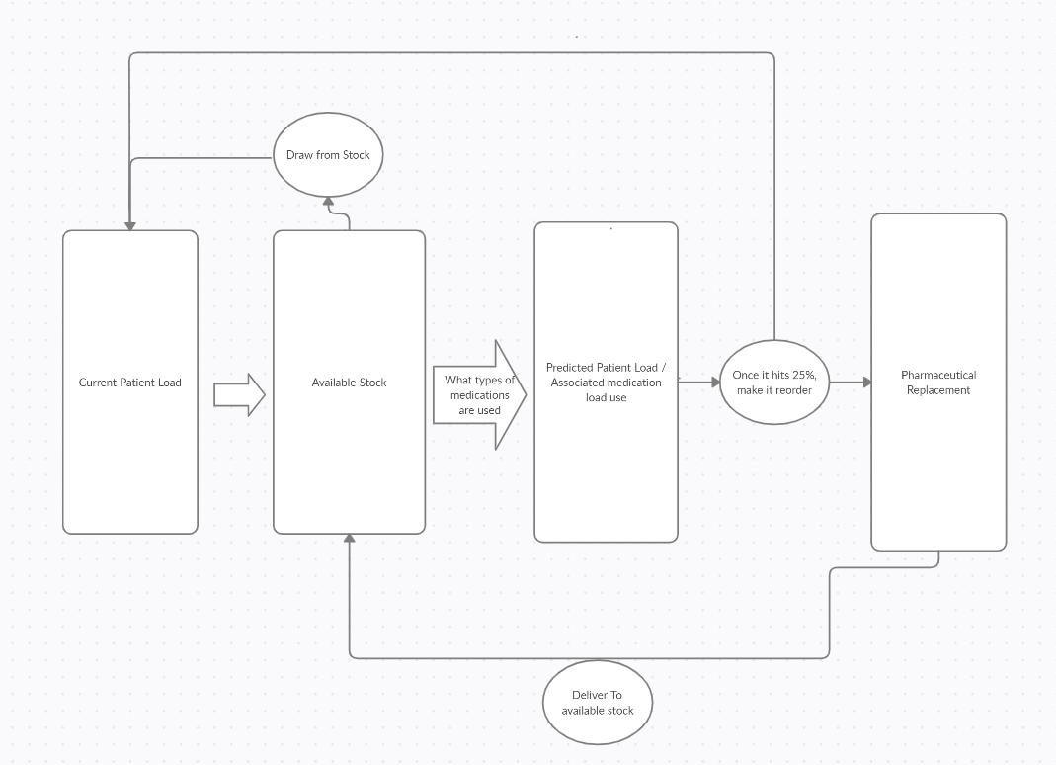
Status matrix for restock
Hard Coded: System checks daily if a restock is necessary as gives an estimate.
Future: Machine Learning will detect most common rate of change based upon numerous days to estimate how long before a restock is needed.

Slide 5
Acyclovir
Amount | 1500 |  | Rate per day | 1500
Day | 1 |  | How much is left before 25% | 58875
Patient | 124 |  | Days before restock needed | 39
Codeine
Amount | 4000 |  | Rate per day | 4000
Day | 1 |  | How much is left before 25% | 222000
Patient | 123 |  | Days before restock needed | 55

Slide 6
Trust levels
Trust levels with range from 0-4 with all of them being determined based on highest % max differences.
0 error means trust level of 4.
Increments in percentages of 5% until reaching a trust level of 0. (Can be adjusted)
Trust levels used to prioritize hospital selection for respondents and consumers
Ensures high trust level hospitals will be prioritized
Can be combined with the Doctor Clinic effectiveness portion to help better help consumers find which hospitals to visit.
How trust levels affect the hospital system in the area is for them to decide.
First to receive and try new technology
Examples could be different prices based on trust levels and if whether the hospital is for-profit or not

Slide 7
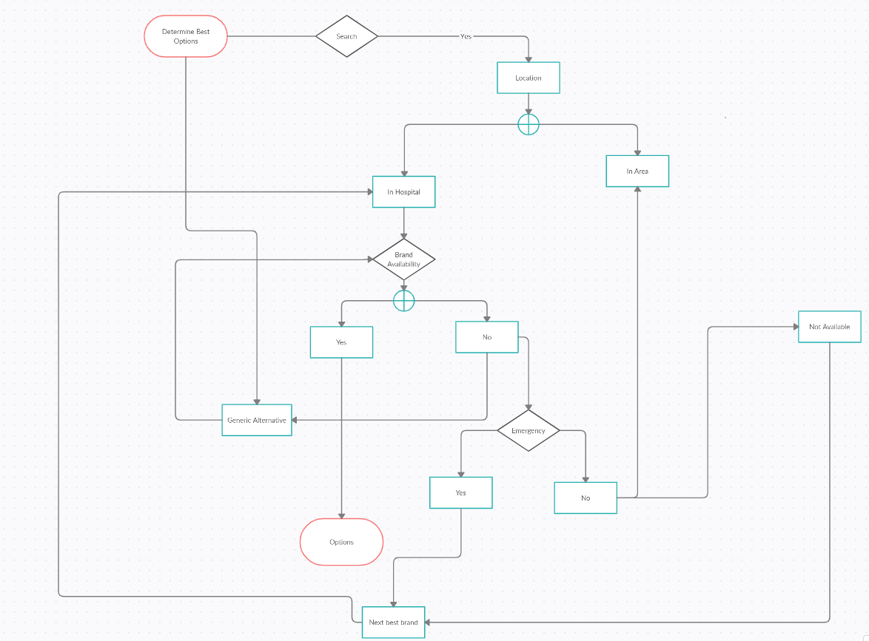
How first-aid respondents and consumers can use trust levels
First aid respondents utilize these trust levels by filtering out which hospital has the highest rate of success including factors of time, location, and sufficient supplies.
If searching for specific option, rather than calling in to determine, the system encompassing the area will already know

Slide 8
Consumers
Consumers can use the same flow chart to find out if the hospital they are searching for can prescribe them the specific medication needed
Flow chart also includes several options and consumers can filter out based upon location and price of similar medications.

Slide 9
Added application of machine learning – risk
In order to apply machine learning for this type of program, a larger sample size is needed for it to find the patterns of a hospitals usage of medications based on the frequency, time of year, variations of medication, anomalies and unusual situations (Covid), etc.

